Slide 1
FIFA World Cup Prediction using Machine Learning
Name: Kadirappa Gari Yeshwanth Sai
Course: B.Tech (AI & ML)
University: Chanakya University
Assignment: Machine Learning Assignment – Tasks 1 to 5

Slide 2
Introduction
Aim: Predict potential finalist teams using machine learning models.
Techniques: Logistic Regression, Random Forest Classifier.
Dataset: FIFA 2022 Full Matches Cleaned Data.
Tools: Python, Pandas, Scikit-learn, Matplotlib.

Slide 3
Task 1 – Data Collection and Preprocessing
• Collected FIFA dataset with team match-level stats.
• Cleaned missing and duplicate records.
• Features: Matches Played, Wins, Draws, Losses, Goals For, Goals Against, Goal Difference, Win Rate.
• Final dataset: FIFA_2022_Full_Matches_Cleaned.csv.

Slide 4
Task 2 – Model Building
• Built Logistic Regression and Random Forest models.
• Train-Test split: 80–20.
• Saved models as logistic_model.joblib and rf_model.joblib.

Slide 5
Task 3 – Model Evaluation
• Evaluated using Accuracy, Precision, Recall, F1-Score.
• Random Forest performed better overall.
• Chosen for final prediction stage.

Slide 6
Task 4 – Feature Importance
• Top Features:
1. Win Rate
2. Goal Difference
3. Wins
4. Goals For
• Generated visualizations: feature_importance_logistic.png, feature_importance_rf.png.

Slide 7
Conclusion & Future Scope
• Successful finalist prediction using ML.
• Highlights data-driven sports analytics.
Future Work:
- Add player-level data
- Include more seasons
- Deploy as a web app.

Slide 8
Task 5 – Final Prediction
• Used Random Forest to predict finalist probabilities.
• Results saved as Predicted_Finalists.csv.
• Displayed top 10 most probable finalists.

Slide 9
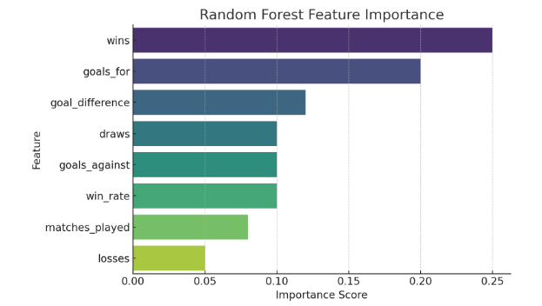

Slide 10
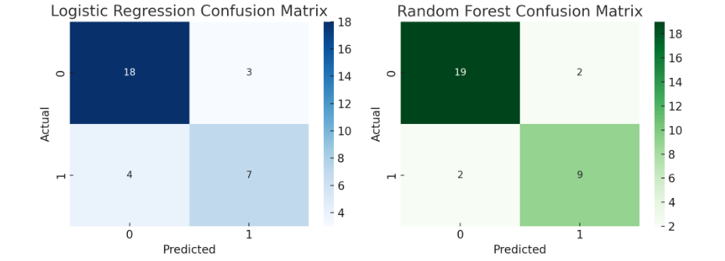

Slide 11
